Slide 1


TRACK AD
By Team
B.N.D.ALEKYA
G.M.AVINASH
KUNAL MISHRA
Guided By:
Abhinandan Chivate

Slide 2
AGENDA:-
1.PROBLEM STATEMENT
2.APPROACH AND SOLUTION
3.MODULES
4.CHALLENGES
5.TAKEAWAYS
6.THINK DIFFERENT WAY

Slide 3
Problem statement:-
Build an interface for managing addresses databases. High Level Need
UI to search and add address. Search should auto completed based on the records in database. Apart from the exact match, the user should have option to run similar search, service build for this should return top 5 similar addresses
Enable option to add multiple address in one request. This can be done by taking file as an input which will have one address per row.
Every address before it is added should be validated against Google Map API (Geocoding api)
Build solution should have UI, spring based API and a database (SQL/NoSQL) for storing data.
Solutions:-
Design the Home Page for our application.
Design Register and Login with alert messages.
After Login, then we should have Search component & there should render all search results with search box.
Create a model for Address as per the google map application interface specifications.
Tech Stack : UI : Angular, Backend : Spring JPA, SQL, JAVA.

Slide 4
Approach and Solution:-
Modules:-
Implementation of Frontend & Backend
Login, Registration and Search Address
Connecting the Frontend and Backend
Search addresses
Validating the Geo map application interface

Slide 5
Spring Boot Flow Architecture
Repository Class Extending CRUD Services
Dependency Injection
Client
Controller
Service Layer
Model
JPA/Spring Data
Database

Slide 6
Angular Flow Architecture:-
Auth Service
Register
App
Login
Router
Auth
Map Service
Search
Core
Upload File
Upload File Service
Navbar
Landing
Footer

Slide 7
Client-Server workflow for Registration and Login:-
Client
Server
1. Post(/api/auth/register)
(username, email, password, confirm password)
User’s Registration
2. Checks if there any existing user in database
3. Return message
(“Registered successfully!!”)
1. Post(/api/auth/login)
(Email, password)
2. Authenticates
(email, password)
Creates JWT token with a secret.
User Login
3. Return JWT response
(token, type, user info, authorities)
4. Requests data with JWT on
Authorization Header
Access Resources
5. Checks JWT signature Get user info & authenticate
Authorize using user’s Authorities.
6. Return response based on authorities.

Slide 8
Angular
Components
Services
Templates
HTTP Client
Spring Rest Controller
SQL Database
Services
Models
Spring Data JPA

Slide 9
Workflow for Search Addresses:-
Search Bar
For Dropdown
Auto Suggestion
Calling the 3rd party api
MapMy India
Fetches
Top Search Addresses
Stores in database
DB
Select from drop down

Slide 10
Upload File
Backend application
Taking input from csv file
File Service
On Failure
Goes to func() to validate
Map My India
DB
Client Request
Store in DB
Validating the address
Success

Slide 11
Challenges Faced:-
We faced a challenge while working with the third party application interfaces.
Validation part for the addresses file using Geo map application interface.
We found some difficulties while creating the search address Frontend part.

Slide 12
Takeaways from the project:-
By working on this project, we got to know many new things like how to handle the errors and the communication between the Front end and Back end part as well as connections also.
We got to know how to use the Third party api’s, which gives us the clarity about the designing part of the api’s and integrating the rest api into the application.
We used many libraries in this project and some of the third party libraries has also been used like map my India to fetch the addresses into the search bar and to store it into the database.

Slide 13
Same project with different methodology:-
Implementing the advanced search filter in angular.
Designing the UI part using React.
Implementing the same project by using different platforms.

Slide 14
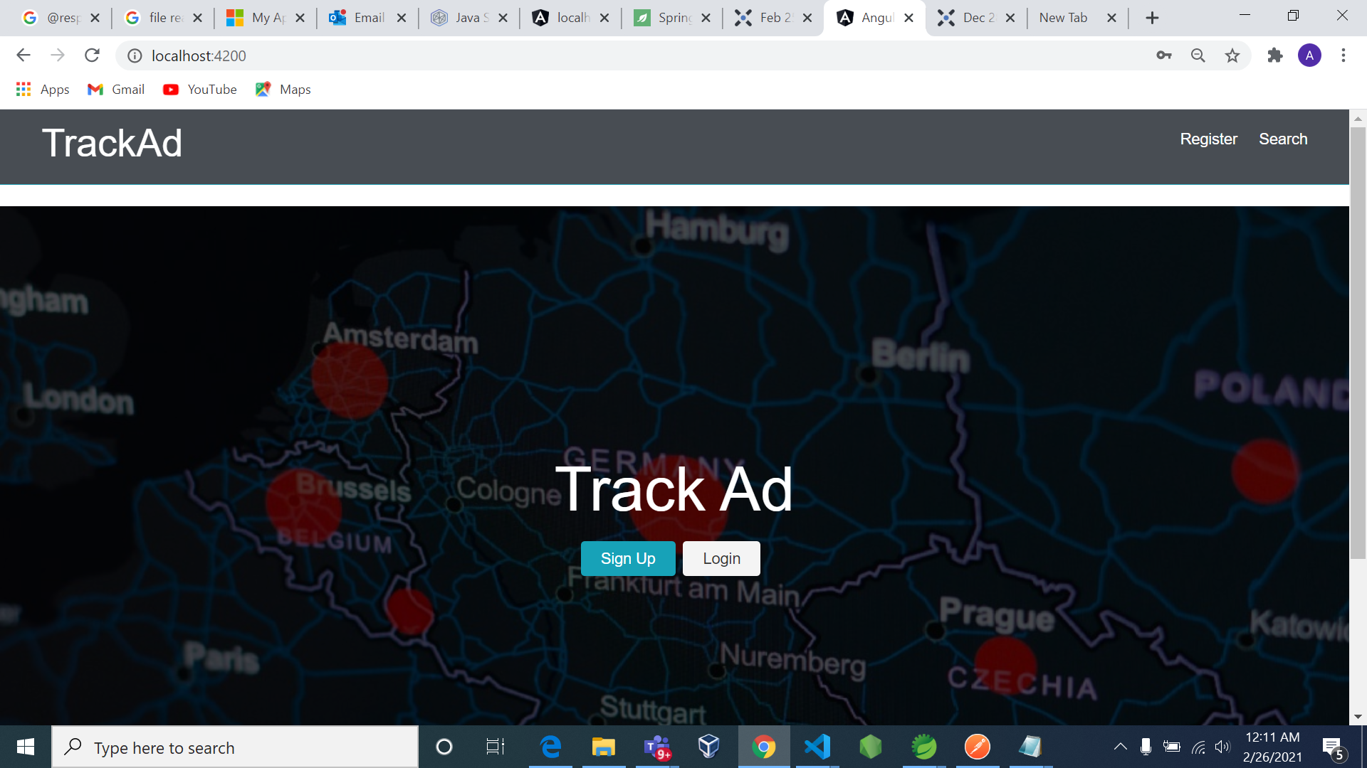
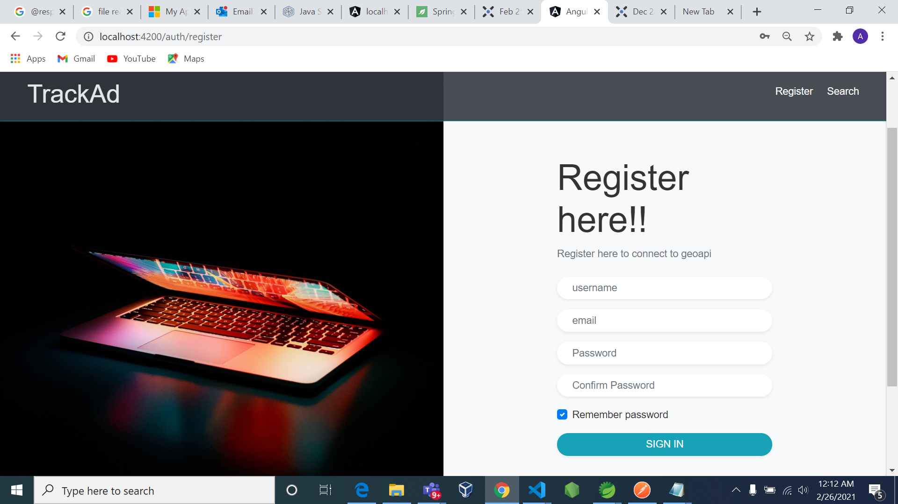
Screenshots of Project:-

Slide 15
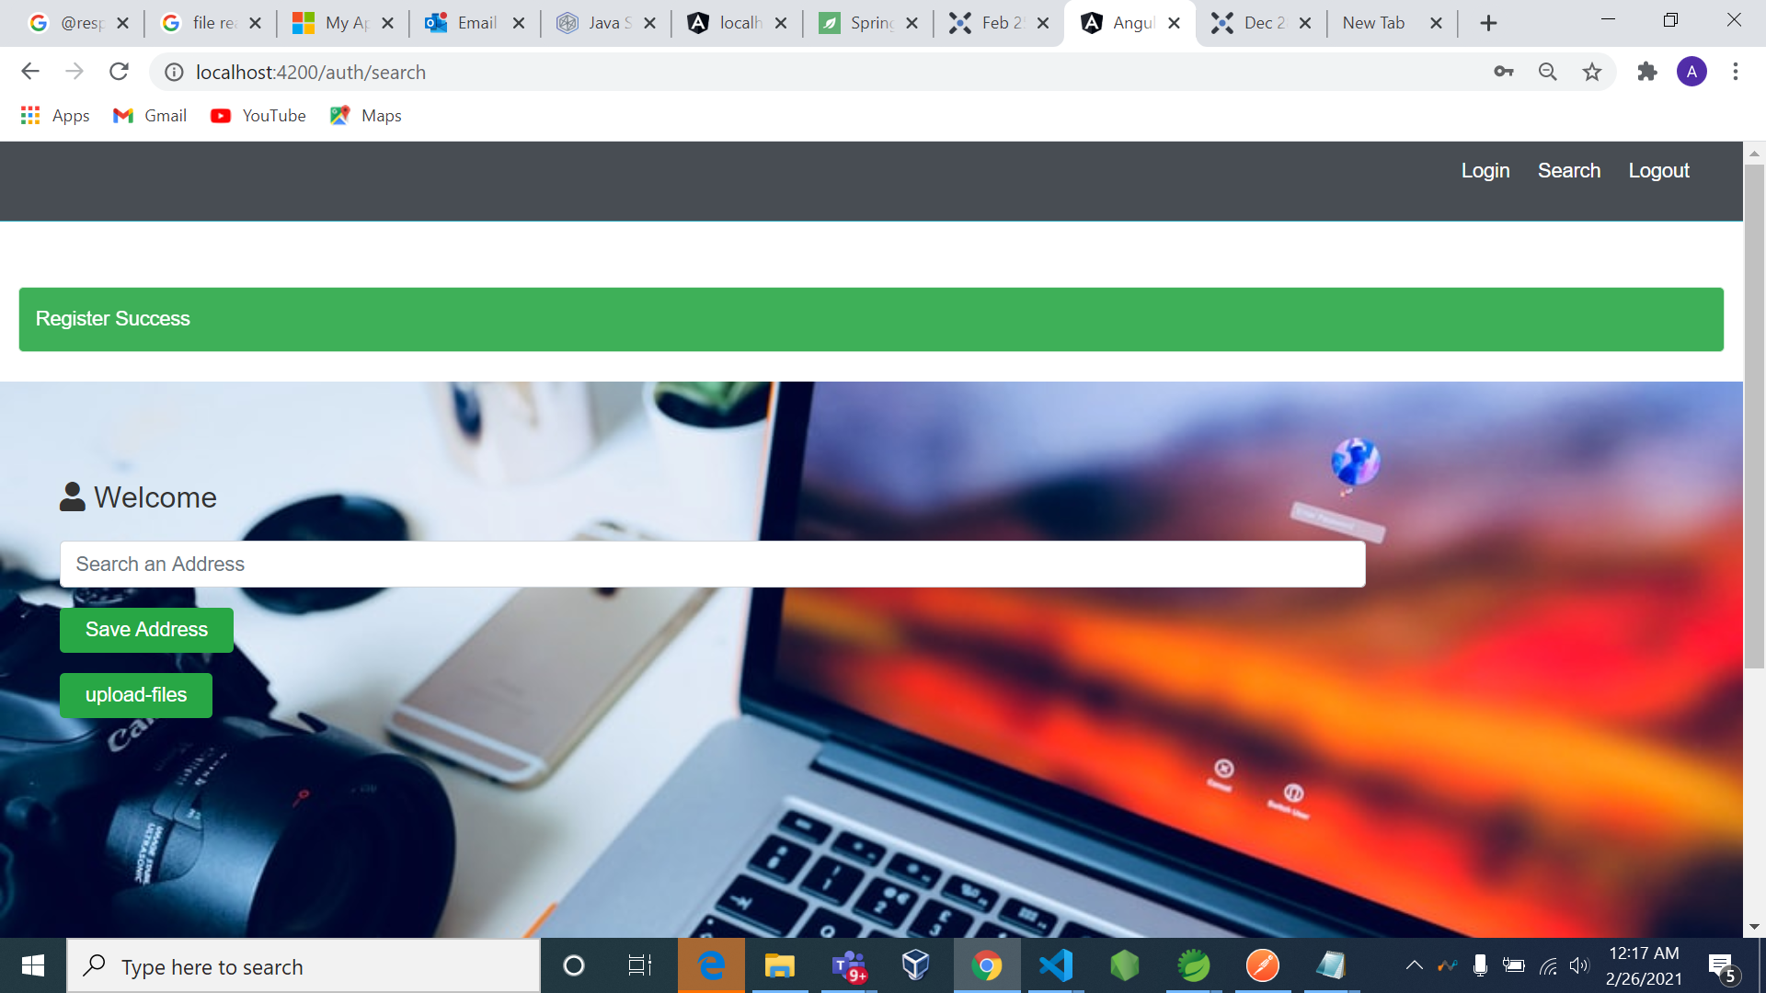
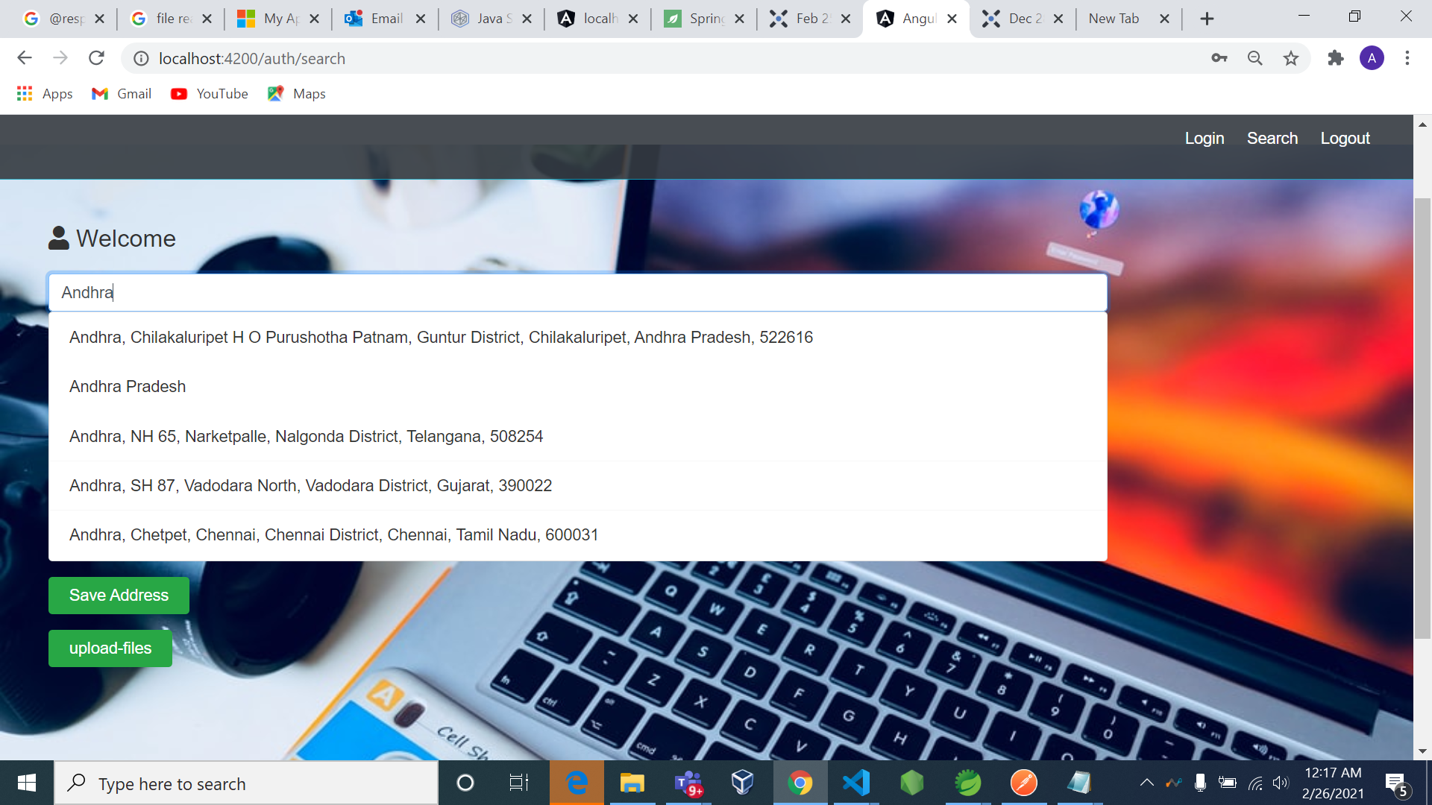

Slide 16
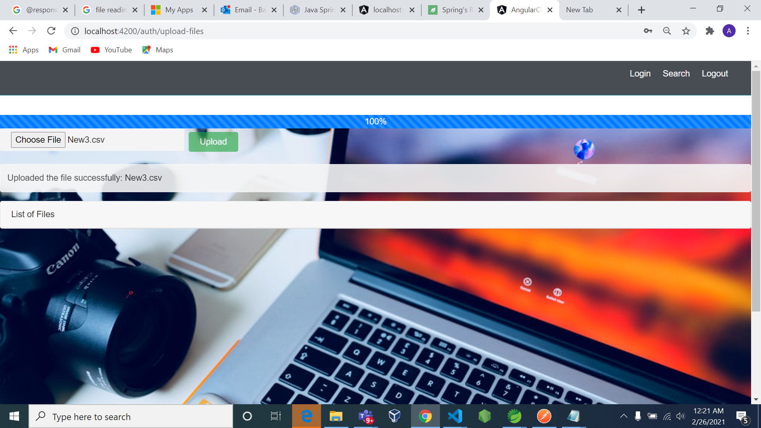
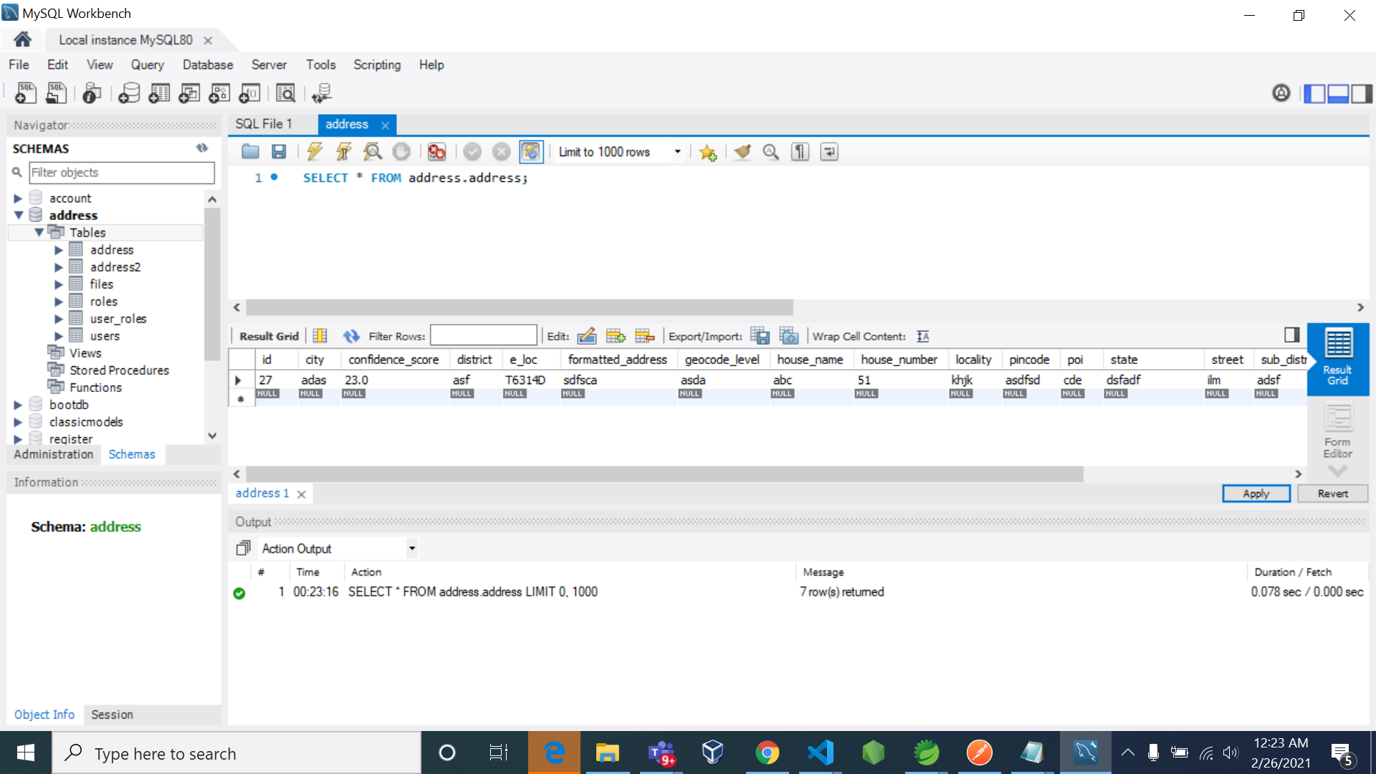

Slide 17
Thank you..

